Slide 1


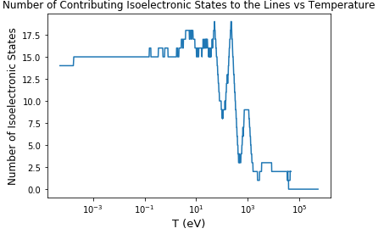
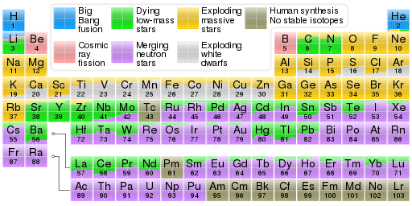
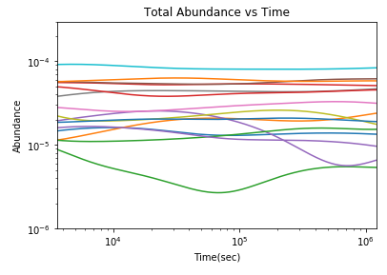
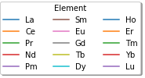
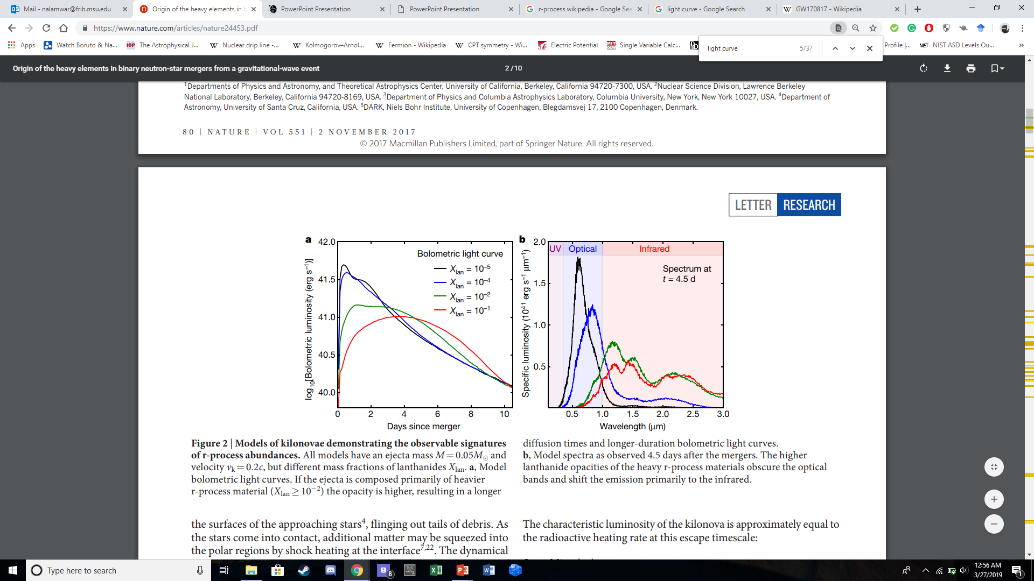
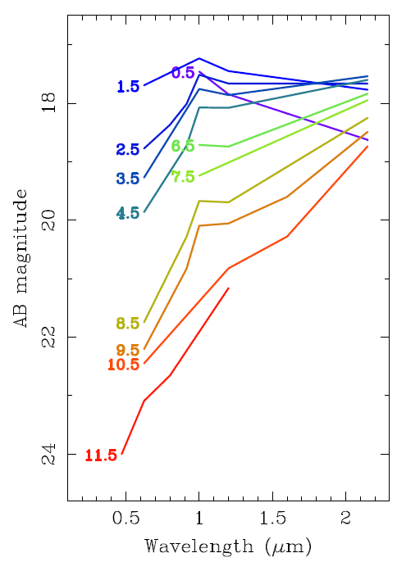
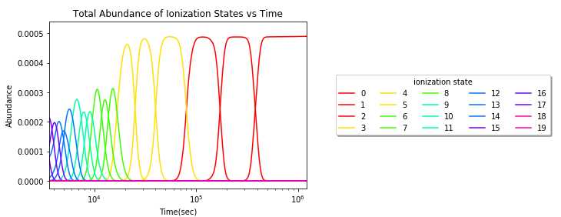
Lanthanide Database for Abundances in Neutron Star Mergers Pranav Nalamwar(Nalamwar@msu.edu)
1 Department of Physics, Michigan State University, East Lansing, MI, 48823, USA.
2 JINA-CEE, Michigan State University, East Lansing, MI, 48823, USA.
_{Origin of the Heavy Elements}
Supernovae, or the explosions marking the deaths of heavy stars, formed the heavier elements through the rapid neutron capture process, or r-process(see Fig.1 for formed elements). Atoms capture neutrons in a neutron-rich environment, creating a radioactive isotope that later decays into stable ones. However, a new class of astronomical event seems to be the source of the remaining r-process elements: neutron star mergers. These neutron star mergers(NSMs) are often the most neutron-rich events in the universe, so they are necessary for the formation of the rather heavy elements(see Fig.1), most notably the lanthanides and actinides. Understanding all the details to this event will uncover why there is a large abundance of elements like gold and uranium. There have been two confirmed NSMs, most notably GW170817 in 2017. This merger also had an associated kilonova, the optical transient AT2017gfo. The kilonova light curve, which shows its brightness over time, is a direct result of r-process elements, especially the lanthanides. How bright and in what bands the kilonova is in is determined by the composition and distribution of the lanthanides. By studying its optical spectra(from here on, spectra refers to optical spectra), one can deduce which elements were created in the merger event as these atoms emit light contributing to this observed spectra.
_{Motivation}
Understanding how the r-process operates in NSMs is necessary to detailing how these heavy elements form. Our goal is to look at which ionization states and isoelectronic states of which elements dominate the merger mixture at late times. Between 1 hour to 2 weeks after the merger, many of the newly formed isotopes don’t have significant variations in their abundance, indicating they contribute both to the optical spectra observed and the overall abundance of the heavy elements(see Fig.3). The kilonova light curve for GW170817 is rather detailed but due to the numerous contributing lines present, the ionization states specific to the lanthanides that are important to the late time merger material should be studied(see Fig.2). Many NSM and kilonova codes use varying atomic databases for opacity and spectra calculations, so by uncovering which ionization states are important, we can measure their properties in a laboratory to benchmark all the atomic calculations used by these codes.
_{Methodology and Procedure}
_{Skynet}⁴, a nuclear reaction network code developed by Jonas Lippuner and Luke Roberts, was utilized to output all the elemental abundances for hydrogen all the way to elements beyond oganesson. The inputs used for Skynet are the starting temperature, electron fraction, entropy, and expansion timescale, which were set to values of 6 GK, .01, 10k_b/baryon, and 7.1 ms, respectively. The Saha equation is utilized here since there is a useful relationship between the nth and (n+1)th ionization states. By solving the Saha equations, we built an abundance function that simply requires the user to input any number of elements they want and which ones to consider. An important idea to note is that the abundance calculation code only utilizes data for elements 1 to 103 since we are focused on the lanthanides and actinides only.
_{Results and Analysis}
Our calculations yielded abundances of all ionization states for all elements between hydrogen and lawrencium inclusive. For all elements, the abundances for late times after approximately 10-4 _{sec or below 10}¹ eV are negligible besides the charge neutral state. For early times, so for temperatures larger than 104 _{eV or before 10}-2 sec, the abundances for most ionization states of any element are 0 except for the much more energetic ionization states and the fully ionized ones. Note that all the abundances should be negligible besides the fully ionized one at early times, but we did not account for electron degeneracy in the mixture. The free and bound electron fractions are calculated independent to Skynet output and contribute to the trends of the total electron fraction. The electron fraction is one of the important aspects of the Saha equation since it is an indicator of how the electrons are distributed in the medium. It affects how abundant certain states can be. All the elements’ ionization state abundances follow the same pattern: as the energy of the system decreases, a given ionization state becomes less dominant at the same time the lower states become significant, thus producing these peaks of the abundances. In fact, the crossing where the dominant species changes is approximately where the transition energy occurs. According to the ionization state calculations, the top 17 states are significant for times of 1 hour to 2 weeks.
_{Conclusion}
Based on the analysis of the abundance graphs, many of the lanthanides’ and actinides’ abundances become significant after the r-process occurs. Once this happens, each element undergoes numerous atomic transitions, resulting in certain ionization states to become dominant in the merger material until the neutral state dominates for low temperatures/late times. The total ionization state abundances of the lanthanides indicate that 17 ionization states are important from one hour to two weeks, but only the neutral state and the first two ionization states are significant on the orders of days to weeks. Figure 7 shows how the number of important isoelectronic states varies over time. At late times, there are 14 important ones, reassuring there are 14 lanthanides to consider.
_{Future Work}
There are a few improvements to consider for this project. For one, we excluded the partition function from the Saha equation due to its complexity. This will certainly impact our final abundance values, so we will account for them later. Also, the electron fraction is degenerate at early times, thus resulting in numerous non-zero abundances to exist at high temperatures. We did not account for this as our focus is on late times/low temperatures only.
Besides accounting for the partition function and the electron fraction degeneracy at early times, we will account for elements with Z larger than 103. Since the NIST table didn’t have these values, we can account for this via ionization potential calculations. Another idea is to optimize and improve the accuracy of the electron fraction calculations as it dictates how the abundances act. We could also alter the initial Skynet parameters, namely the electron fraction, and then average the abundances over the different scenarios. The next major step, however, is to set up an experiment that can measure the properties of the top 17 ionization states, such as the lines of each. To do this, we can create a mixture of these and measure the opacity of it.
_{Work Cited}
¹Tanvir, N. R., et al. “The Emergence of a Lanthanide-Rich Kilonova Following the Merger of Two Neutron Stars.” The Astrophysical Journal, vol. 848, no. 2, 2017, doi:10.3847/2041-8213/aa90b6.
² Kasen, D . Et al. (2017). Origin of the heavy elements in binary neutron-star mergers from a gravitational-wave event. Nature,551(7678), 80-84. doi:10.1038/nature24453
³Johnson, Jennifer. “Origin of the Elements in the Solar System.” Science Blog from the SDSS, Sloan Digital Sky Survey, 28 June 2017, blog.sdss.org/2017/01/09/origin-of-the-elements-in-the-solar-system/.
⁴Lippuner, Jonas, and Luke F. Roberts. “SkyNet: A Modular Nuclear Reaction Network Library.” The Astrophysical Journal Supplement Series 233.2 (2017): 18. Crossref. Web.
⁵Kittel, Charles, and Krömer Herbert. Thermal Physics. Freeman, 1980.
_{Acknowledgements}
_{Jaideep Singh and Luke Roberts}
This work is supported by Michigan State University, the Honors College of Michigan State University, and the Joint Institute of Nuclear Astrophysics.
Equation 1: The Saha equation⁵ (top) is the backbone of all the ionization state abundance calculations. Y_{Z,I+1} / Y_{Z} refers to the ratio of the Z+1 ionization state abundance to the Zth ionization state abundance. Y_{e,tot} is the total electron fraction of the merger material, f is the proportion of the Y_{e} that is free, and χ_{i} is the ionization potential of the ith ionization state
Figure 4: Plot of abundances for all lanthanides over time (left) based on output from Skynet. Note that the abundances at early times is noise considering there are values lower than 10⁻²⁰. Values become significant around 10⁻¹ sec.
Figure 7: The isoelectronic states abundances vary greatly over temperature. By using a minimum threshold abundance of 10⁻⁶ ,we found the number of isoelectronic states contributing to the number of lines affecting the kilonova light curve to be around 14.
Figure 1: Periodic table of the elements color coded by the element source³. Note the trend where most of the elements, starting from Sr to Pu, are mainly created by neutron star mergers. Other contributions come from supernovae.
Figure 2: This light curve by Kasen et al.² depicts the changes in the amount of light emitted by the ejecta mass, each with different fractions of lanthanides.
Figure 3: AB magnitude, or the absolute magnitude based on spectral flux densities, vs the wavelength for the spectra of AT2017gfo across 12 days of observation¹. Note the various color changes in the overall spectra from blue to red since the start of observations.
Figure 6: Relative abundance graph of all the lanthanides’ ionization state abundances as a function of time in the merger material. The various colors represent the unique ionization states and the first 17 states are dominant at cool temperatures.

